Slide 1
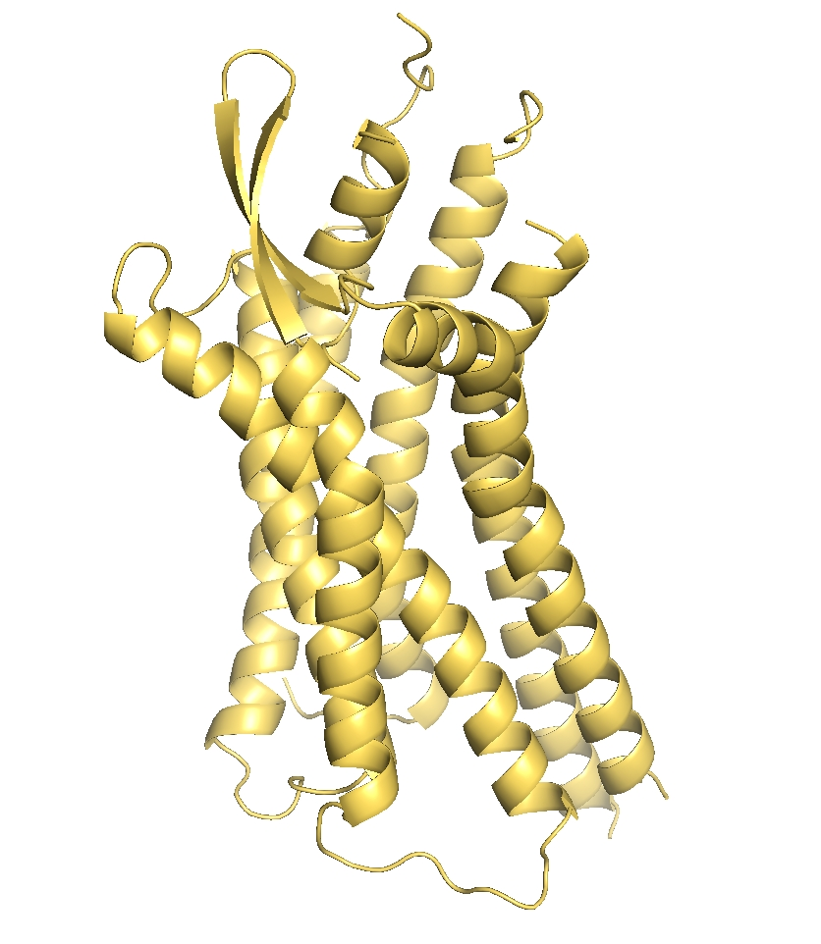






Learnable Gaussian Filters
Manifold Harmonic Message Passing
$$(N,n)$$
Concat
Feature Extraction
$$(N,n)$$
$$(N,2n)$$
$$F^{mp}=Φ$$
$$⊙Φ+F^{inp}$$
- Molecular Property Regression
- Ligand-Binding Pocker Classification
SASA/PDB
$$\left(N,N\right)→(N,k)$$
Eigenfunction Computation
Pre-computed
Tasks
Manifold Harmonic Message Passing

